Slide 1




CodeAssist
Nishant Velagapudi, Sohag Desai, Charlotte Swavola, Zhaoning Yu
Notes:
Good afternoon everyone. Charlotte, Nishant, Zhaoning and myself are part of the team that has developed CodeAssist, an intelligent system that utilizes surgeon notes and patient demographic information to help predict accurate hospital billing codes. We all know that one of the primary problems facing us today is the rising cost of healthcare. We believe we’ve nailed one of the factors that drive up the administrative costs and expenses related to hospital procedures and surgeries, not to speak of the stress on patients and surgeons when there are errors, since they have to deal with insurance companies to correct these.

Slide 2



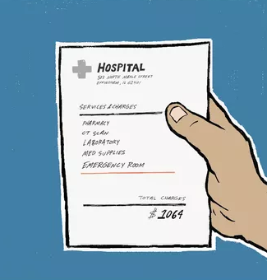

Problem Storyboard
Billing errors often total more than $1300 per bill, and insurance claims can be rejected due to incorrect billing codes³.
Facility enters billing code
Insurance Billed
Mismatch could result in claim denial or payment delay. Up to 80% of billed cases contain some form of error².
Patient Billed
Surgeon enters billing code
Surgeons don’t enter correct code before facility, partially due to ineffective workflows¹.
Doctors wasting over two thirds of their time doing paperwork (Forbes): https://www.forbes.com/sites/brucelee/2016/09/07/doctors-wasting-over-two-thirds-of-their-time-doing-paperwork/#5e3d4ec75d7b
Medical Billing (Healthcare business and Technology): http://www.healthcarebusinesstech.com/medical-billing/
Medical Billing Errors Are Seriously Hurting Healthcare (Healthcare via Employee Benefis Advisor): https://healthcareinamerica.us/medical-billing-errors-are-seriously-hurting-healthcare-67d134441adc
Notes:
Here is the problem statement. The scenario we address starts with a patient consulting with a surgeon for an outpatient procedure. The surgeon makes some preoperative notes after the initial
Scenario: outpatient surgeries
Surgery can deviate from exact expectation
Hospitals bill insurance with incomplete information
Limited by EMR structure
Billing done by third parties with less experience
Surgeons often finish case billing late
Potential mismatch between the work done and billing
Compliance
Insurance claims denials
Impact to patient

Slide 3



Proposed Workflow
Demographics
PreOp Free Text
PostOp Free Text
Operation
Facility enters billing code
Pre Op Notes
Procedure Info
Patient Info
Facility Workflow
Post Op
Notes
CodeAssist
Risk Ranking
CodeAssist
Prediction
Surgeon/ Anesthesiologist reviews preliminary codes
Notes:
The first feature of our product predicts the codes to streamline the billing process for the practitioner. Our model uses the free text operative notes as well as the patient demographics to predict what happened in the operation room, and presents these choices to the surgeon or anesthesiologist. This streamlines the billing process in order to align the facility and surgeon timelines.
The second feature, risk prediction, assess the depth of information present in a case file to evaluate the likelihood of a billing error by the facility coder. This prediction could be used to prioritize cases in a workflow and maybe prompt follow up actions like contacting the surgeon for more information.
Product concept:
Intelligent system for billing upon surgery completion
Parse preoperative free text, combine with surgical staff details, patient details
Streamline billing process and elicit response from surgeon immediately post-op
Surface intelligence to administrative staff at billing time
MVP / User feedback
Predict which cases are high risk for incorrect billing
Predict output Anesthesia codes

Slide 4
CodeAssist Performance Summary
 |  | All Cases |  |  | Single Output Cases
 |  | Human* | PreOp Notes | PostOp Notes | Human* | PreOp Notes | PostOp Notes
Billing Code Prediction | Surgery | 49.4% | 39.75% | 44.50% | 67.30% | 56.50% | 61.10%
 | Anesthesia | 72.90% | 75.10% | 77.30%
Risk Prediction | All | 57.9% | 70.70% | 71.56%
*Human results values are not based on binned predictions
Notes:
With an initial data set of 19.6k cases, for each of which there are up to 10 billing codes to predict, CodeAssist has an accuracy of 44% for predicting all codes for a given case, and 62% accuracy for predicting the primary billing code. This puts or code prediction only 5% behind the experts that do this every day.
For our risk prediction product, our CNN model is able to predict correct and incorrect cases with 72% accuracy, effectively streamlining the workflow

Slide 5
Pre-model Processing
Notes:
Thank you Charlotte. Hello everyone. I am going to talk about the preprocessing that we carried out in order to improve the efficiency of the model and how this relates to some of the performance metric priorities we followed in our product design decisions.
We carried out two major preprocessing steps: Text Cleaning and Code Grouping or Binning.
-------------------------------------------------------------------NOT USED-----------------------------------------------------------------------------------------------
We performed a number of steps on the data in order to transform it into a form more amenable to creating a model:
We used OutPatient data instead of InPatient,
Remove NA, Tokenize
Lowercase / Deduplicate
Removal of Stopwords
Binning
I will touch upon these techniques that made a substantial difference in the couple of slides.

Slide 6
Preprocessing Step 1: Text Feature Cleaning
Pre Op Notes
Procedure ID
Patient Info
Text Pre-Processing
Apply Model
Billing Code
Predictions
Post Processed
(Count = 44214 records)
Preop Notes
(Count = 49700 records)
Cardiovascular disease HTN, hyperlipidemia Arrhythmia a-fib and sick sinus syndrome Cardiac rhythm management device Medtronics pacemaker Diabetes type II diet controlled GERD Crohn's disease Neurological disorder Musculoskeletal disorder Coagulopathy warfarin tx for a-fib Smoking history
cardiovascular diseas hyperlipidemia arrhythmia sick sinu syndrom cardiac rhythm manag devic medtron pacemak diabet type diet control gerd crohn diseas neurolog disord musculoskelet disord coagulopathi warfarin smoke histori
Remove NA, Tokenize
Lowercase, Deduplicate
Remove Stopwords
Stem, Lemmatize
Top 5 terms (total 11100 unique terms)
musculoskeletal 24558 neurological 20743 cancer 17601 cardiovascular 17223 gerd 16001
Notes:
Let’s start with Text Cleaning. This diagram shows the text preprocessing steps we implemented on the preoperative notes input that we used to develop the model. There are four stages: Stage 1 involves NA removal and tokenization, Stage 2, lowercasing and deduplication of the tokens, Stage 3, removal of stopwords which carry no useful signal and Stage 4: stemming and lemmatization, that is, reducing words to their root form, normalizing tenses and transforming relevant word forms to the first person.
The words highlighted on the left are examples of stemming and lemmatization transforms. The unhighlighted words were dropped as they were stopwords.
A checkpoint involved determining the most frequently occuring medically relevant terms, These constitute the signal that is used to inform the model.
--------------------------------------------------------------------------------------------------------------------------------------------------------------------------
Text processing could always be improved. Additional steps that could be taken could include:
Additional stopword removal (using TF-IDF filtering)
Combining terms that are alternately used such as htn & hypertension
--------------------------------------------------NOT USED---------------------------------------------------------------------------------------------------------
As shown in the diagram, text processing involved the following stages:
Removal of NA records and those with white spaces
Tokenization of records with ‘/’, ‘,’ and similar
Lowercasing and deduplication
Removal of stopwords, including generic medical terms such as “disease”, “disorder”, “illness”
Lemmatization - words reduced to their root form.
Stemming - words in third person are changed to first person and verbs in past and future tenses are changed into present.

Slide 7

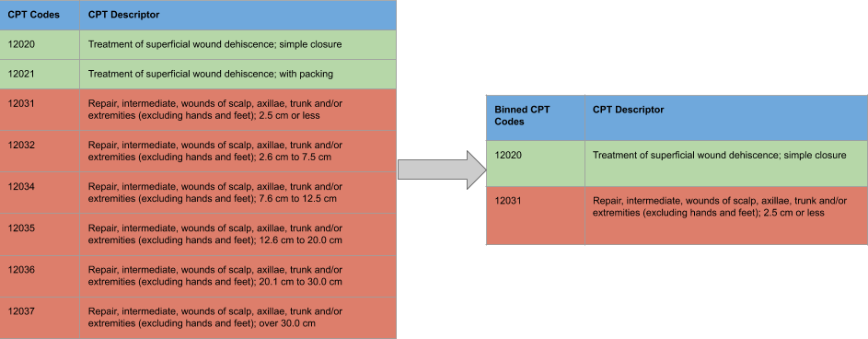
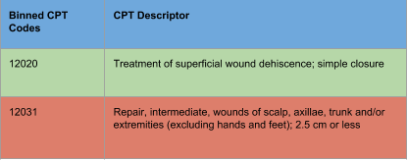
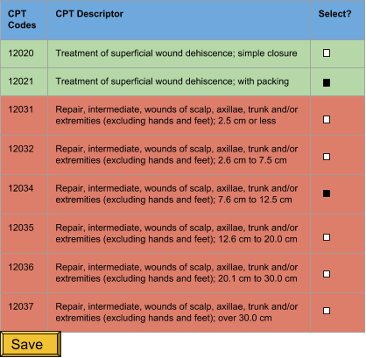
Preprocessing Step 2: Binning
Codes
Codes
Mobile Device
Bins
Predicted Bins
CodeAssist
Bin
Expand
3878 Classes
CodeAssist model
6247 Classes
Surgeon chooses code
from predicted, re-expanded bin
Train
Predict
Notes:
Next, I’ll talk about the second preprocessing step, namely binning. What do we mean by binning? Briefly, the CPT codes to be predicted fall into over 6,000 classes. Our dataset was relatively small, for the large number of classes to be predicted as Charlotte mentioned, so we examined the codes to see if we could group them. Indeed, we found that many codes were clustered into groups rather similar to each other, differing only in specific dimensions or details that would be hard to predict from the preop notes alone. You can see a couple of examples on the left hand side of the diagram. We therefore engaged in a preprocessing step to group like codes together and predict the group or bin rather than the specific code. This reduced the number of classes to be predicted to less than 4,000.
We don’t restrict the surgeon to the bin, however; as shown in the right hand side of the diagram, our product expands the predicted bin into its constituent codes and allows the surgeon to select the relevant code or codes prior to sending it on for further processing.
We’ll see in the next slide what this means to the performance of our system.
----------------------------------------------------------------------Notes-----------------------------------------------------------------
Prioritize Recall over precision, as a UX choice
Product choice to offer options instead of fully automating
Part of that is predicting bins and presenting all binned options
Related CPT codes are consecutive
Group these codes into a single bin
Predict the bin rather than the code
Reduction in number of codes to be predicted from complete set of CPT codes:
6247 => 3878
Reduction in number of codes in dataset:
3361 => 1912
The second noise reduction technique employed is grouping or binning of billing codes. This is motivated by the fact that the number of billing code outputs is huge and the dataset is relatively small so any reduction in the set of predicted output will help in improving the performance of model.
We observed that sequential codes tend to describe very similar ailments or conditions
We realized that grouping similar codes by ignoring the differences related to detail such as size of incision we could achieve better prediction by predicting the bin rather than the specific code.
We validated this assumption with our SME
Looking at the category reduction the problem domain is simplified significantly
The next slide shows the improvement in the results due to adopting this approach

Slide 8
Performance Prioritization: Recall Preferred
Metric | Product Outcomes | User Impact
Accuracy | Shows more True +ves and fewer False -ves | Is a bonus; would be critical for full automation
Precision | Shows fewer correct and incorrect options, including fewer True +ves | Reduces number of codes shown: codes more likely to be relevant
Recall | Shows more correct code options, including more True +ves | Less missing codes in prediction set surfaced in app
Notes:
With binning, we improve accuracy, as you would expect as there are fewer classes to predict. When we expand the bins, we surface all of the CPT codes within a bin and therefore improve recall. However, precision takes a hit.
What do the SMEs say about this? We spoke with medical professionals and we found this tradeoff to be acceptable. The bins are expanded and presented to the surgeon. Even though this means there are more codes for the surgeon to look at, false positives can easily be skimmed over whereas false negatives require a surgeon to hunt down additional billing codes.
This prioritization theme persists through the project as you will see with surgeon-specific models which Nishant talk about.
----------------------------------------------------------------------Notes-----------------------------------------------------------------
Prioritize Recall over precision, as a UX choice
Product choice to offer options instead of fully automating
Part of that is predicting bins and presenting all binned options
Related CPT codes are consecutive
Group these codes into a single bin
Predict the bin rather than the code
Reduction in number of codes to be predicted from complete set of CPT codes:
6247 => 3878
Reduction in number of codes in dataset:
3361 => 1912
The second noise reduction technique employed is grouping or binning of billing codes. This is motivated by the fact that the number of billing code outputs is huge and the dataset is relatively small so any reduction in the set of predicted output will help in improving the performance of model.
We observed that sequential codes tend to describe very similar ailments or conditions
We realized that grouping similar codes by ignoring the differences related to detail such as size of incision we could achieve better prediction by predicting the bin rather than the specific code.
We validated this assumption with our SME
Looking at the category reduction the problem domain is simplified significantly
The next slide shows the improvement in the results due to adopting this approach

Slide 9
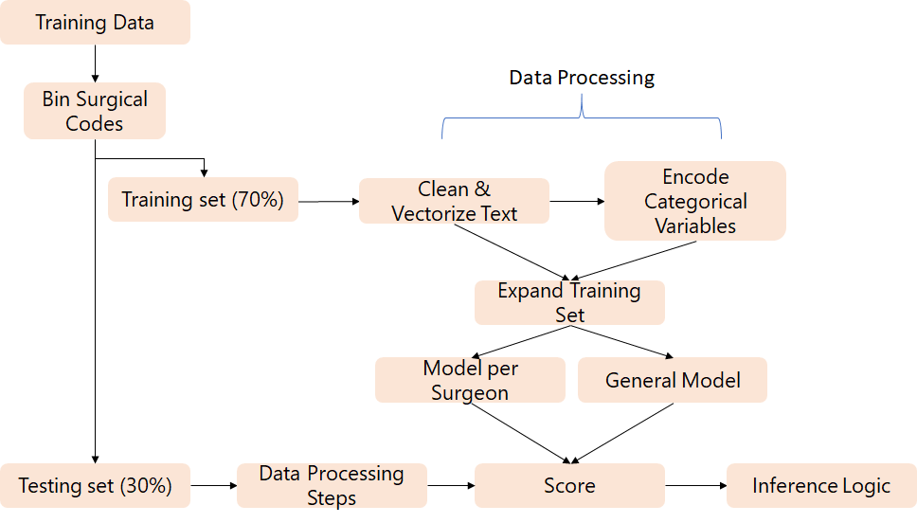
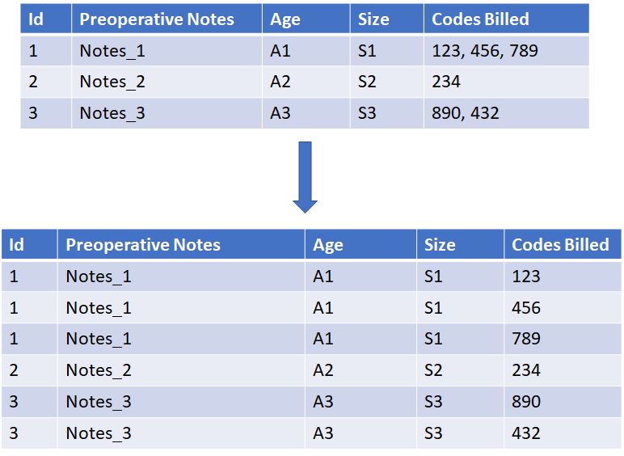
Technical Approach: Workflow

Slide 10
Technical Approach: Workflow

Slide 11
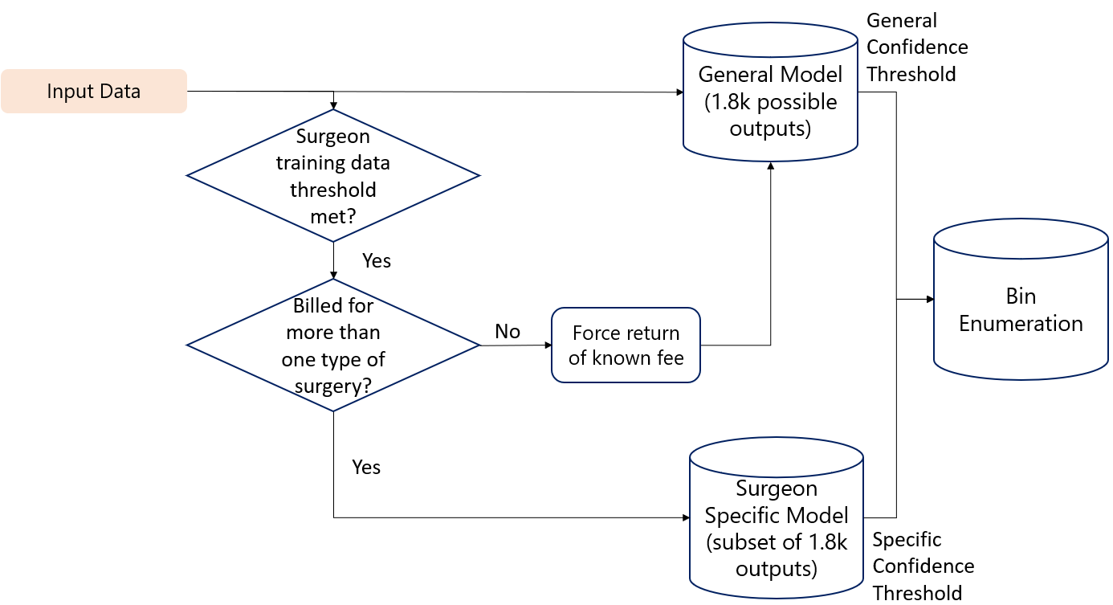
Technical Approach: Inference Logic
Notes:
Operative notes key feature Relatively few surgeons in set: surgeon specific models viable Fine granularity clusters of outputs improve performance without sacrificing inference value

Slide 12
Technical Approach: Surgeon Specific Results
+3%
Accuracy
-4%
Precision
+5%
Recall
Benefits:
Better performance case-by-case
Updated logic combines benefits of specific and general models
Surgeon specific models catch tendencies (personalized language + limit outputs)
General model leverages combined set for generalization
False negatives lead to worse surgeon experience than false positives

Slide 13
CPT Prediction Technical Summary
Unique Features:
Multiple output predictions & consumes multiple labels per training data
Binning CPT code outputs
Models per surgeon
Inference logic to combine general & surgeon specific models
Value Add:
Predict all CPTs performed in given surgery with one prediction
Generalized predictions - surgeon inputs for specifics
Optimal predictions for high volume surgeons
Combined benefits of strongly generalized model with specific learning for high volume surgeons

Slide 14
CodeAssist Risk Prediction
Notes:
A: Why need risk prediction?
It is a hard problem: (1) input can be mapped to multiple codes (2) and the number of codes is not fixed
To solve the problem exactly is difficult, but there is an easier problem - given the inputs, predict the risk of hospital billing error.
Then even though we cannot automatically generate all the codes, we can highlight the high risk cases, then the hospital can focus on these high risk cases to prioritize their work flow.
A: Is it possible?
Language people use has this information, for example, EDA shows the text lengths difference, we re-frame it as a text-classification problem: given the text input by doctors, that is the text will be seen by the hospital billing staff, we predict the risk of billing error.
A: How to do it?
Text length does not has enough information, we use CNN, which detects the pattern in language.
Short description of CNN text classification, and architecture.
A: What are the results?
(1)base line is 57%, given the amount of data we have, we can detect 70% of the cases.
(2) with more data, we expect better performance.

Slide 15
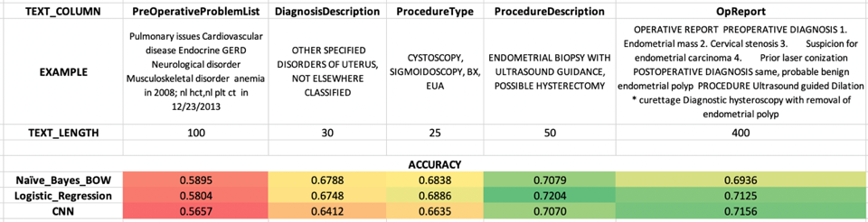
CodeAssist Risk Prediction
Pre Op Notes
Procedure Info
Patient Info
Procedure Description
Binary Error Prediction (CNN)
Surface Error Probability
Post-Op notes
Binary Error Prediction (CNN)
Surface Error Probability

Slide 16
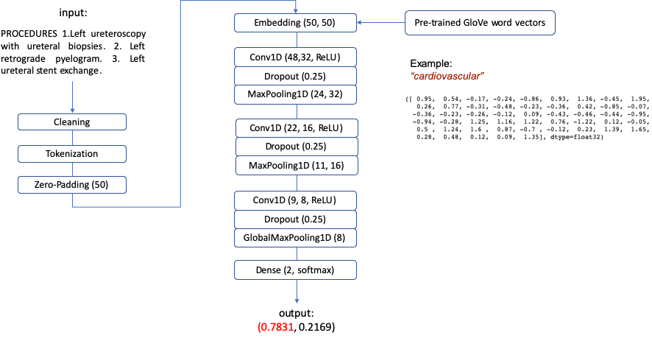
CNN Risk Predictor Architecture
CNN design choices:
Word vectors Initialized with pre-trained GloVe but trainable
L2 regularization
Dropout
Pre-processing:
Lowercase
Numbers, spaces, stopwords...
Stemming/Lemmatization
Notes:
A: How to do it?
Text length does not has enough information, we use CNN, which detects the pattern in language.
Short description of CNN text classification, and architecture.
BIG PICTURE: given text input (either the pre-operation or post-operation notes from the surgeon), we predict the probability that the hospital making a billing mistake.

Slide 17
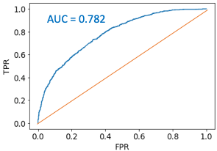
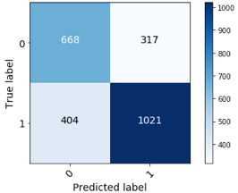
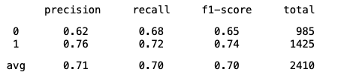
CNN Risk Predictor Performance

Slide 18
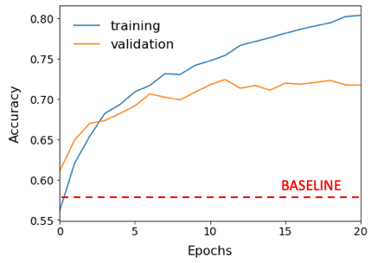
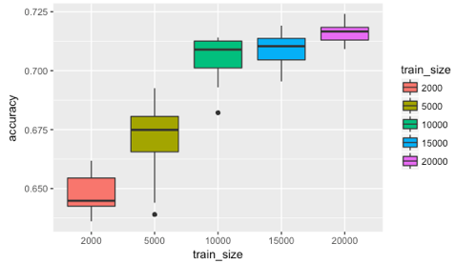
CNN Performance vs. Train Size
Train Size
BASELINE accuracy: 57%
CNN accuracy: 70%
Expecting better performance with more data
Notes:
A: What are the results?
(1)base line is 57%, given the amount of data we have, we can detect 70% of the cases.
(2) with more data, we expect better performance.

Slide 19
Demo

Slide 20
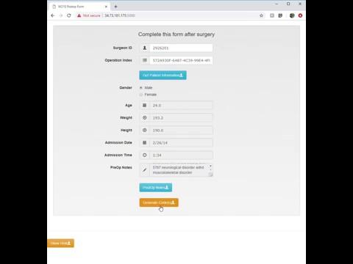
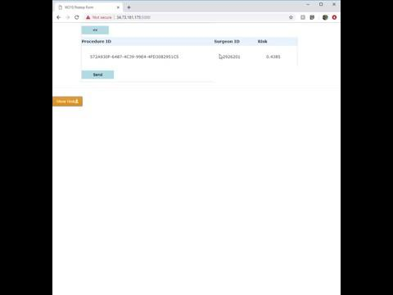
Billing Code Prediction
Risk Prediction

Slide 21
Thank you!
CodeAssist Overview:
https://cswavola.github.io/_projects/codeassist

